Slide 1
About ROS2
>>ros2 topic list
/fmu/in/actuator_motors
/fmu/in/actuator_servos
/fmu/in/arming_check_reply
/fmu/in/aux_global_position
…
>>ros2 topic info /fmu/in/trajectory_setpoint
Type: px4_msgs/msg/TrajectorySetpoint
Publisher count: 0
Subscription count: 1
>>ros2 interface show px4_msgs/msg/TrajectorySetpoint
# Trajectory setpoint in NED frame
# Input to PID position controller.
# Needs to be kinematically consistent and feasible for smooth flight.
# setting a value to NaN means the state should not be controlled
uint64 timestamp # time since system start (microseconds)
# NED local world frame
float32[3] position # in meters
float32[3] velocity # in meters/second
float32[3] acceleration # in meters/second^2
float32[3] jerk # in meters/second^3 (for logging only)
float32 yaw # euler angle of desired attitude in radians -PI..+PI
float32 yawspeed # angular velocity around NED frame z-axis in radians/second
>>ros2 topic echo /fmu/out/vehicle_local_position
Nodes(Functions or Programs) and Topics (Global Variables)
Publisher – Writes to a topic, Subscriber – reads from a topic
Useful Topics
/fmu/out/vehicle_local_position
/fmu/in/trajectory_setpoint

Slide 2
Architecture
ROS2/PX4/Quadrotor
/fmu/in/trajectory_setpoint
/fmu/out/vehicle_local_position
Safety Layer
/safe_topic
Controller
(Your Code)

Slide 3
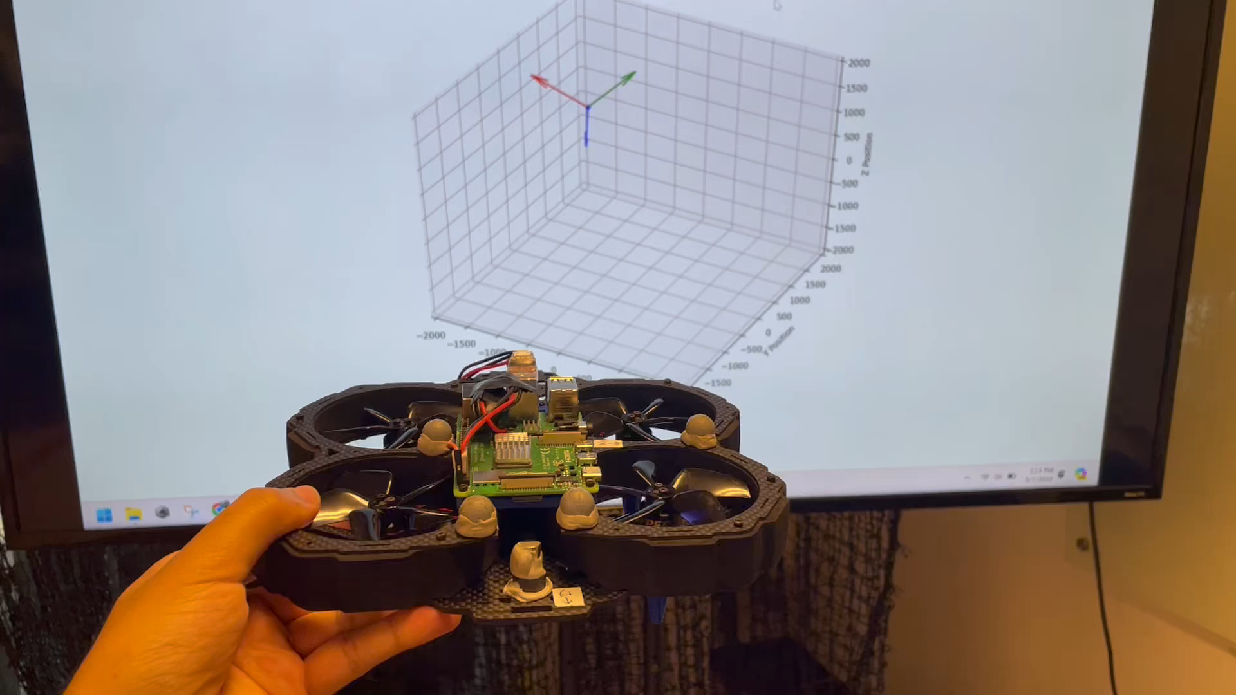
State visualizer

Slide 4
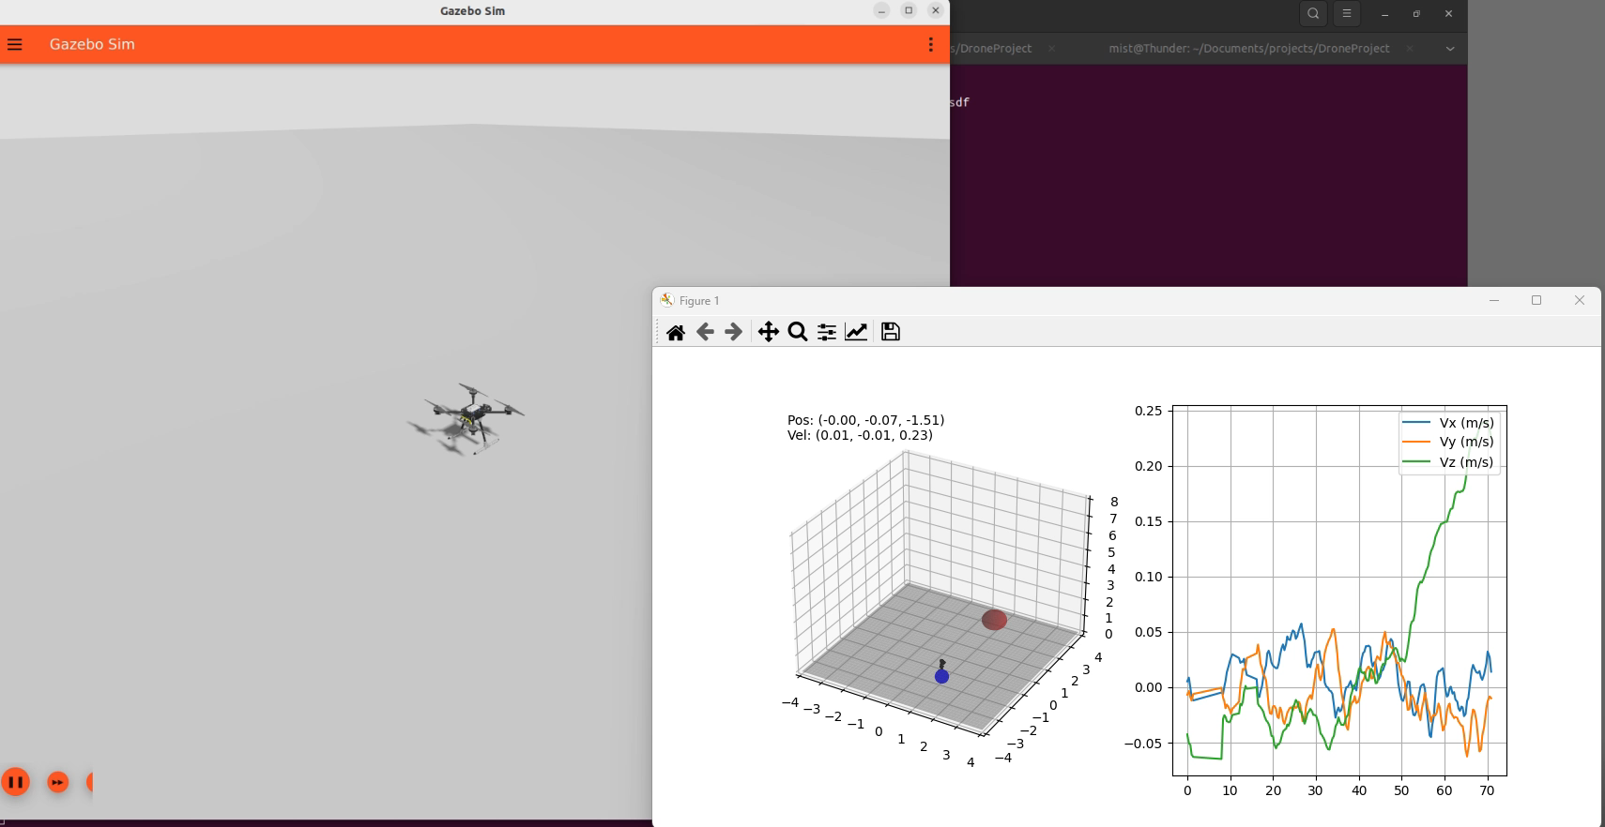
MPC based guidance with trajectory avoidance

